Slide 1


Titolo presentazione sottotitolo
Data Ingestion Pipeline for Real Time Machine Learning
Milano, XX mese 20XX
8/04/2021

Slide 2
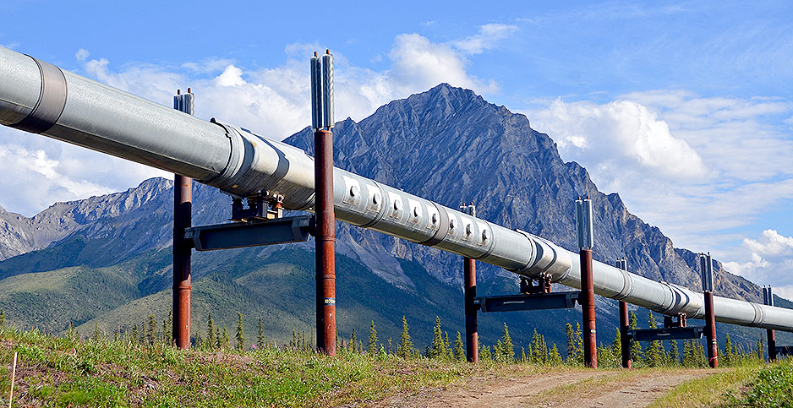
What Is A Pipeline?
A pipeline is a chain of software that process a stream of data
Each software takes the incoming data, process it and forwards it to the next component of the pipeline

Slide 3
Why Do We Need A Pipeline?
Production environments are different from developments one:
Data are not already fully available as they come in real-time from thousands of producers (streamed data)
Time requirements on the processing are strict (real-time)
The production environment should be fault-tolerant and adapt to peaks of work (replicated and scalable)
We need specialized software to support these requirements

Slide 4
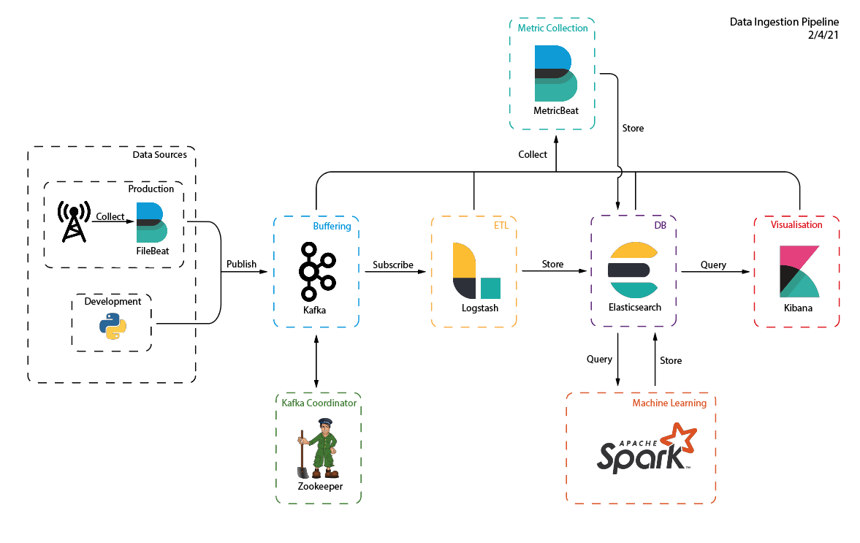
Pipeline Overview

Slide 5
Inputs Of The Pipeline
The Siae Performance monitoring dataset is used, but any data source that provides atomic logs can be used.
On development a Python script that simulates the production of logs
On production Filebeat collects classical textual logs from an observed directory or poll link monitoring API and publish them on Kafka

Slide 6

Messages broker built upon publish-subscribe pattern
Used as a buffering queue to handle peaks of work and to separate different source types
Data producers publish their messages on a specific topic (pm, alarms)
Each topic is a distinct and independent queue
Multiple consumers can read a different subset of messages from the same topic by exploiting topic partitions and consumer groups
Multiple instances can be grouped to form a cluster (using Zookeeper)

Slide 7

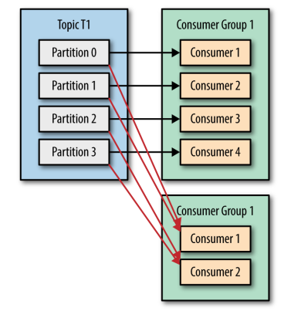
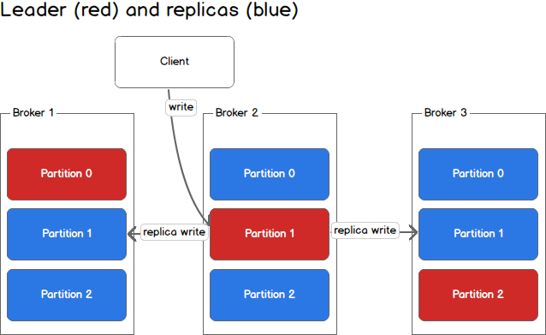
Kafka Cluster Architecture

Slide 8

ETL tool
Consumes Kafka topics, transforms and sends them to the storage as JSON documents
Simple deployment: it just requires a pipeline file that describes the input, transformation and outputs.
Stateless: each message is threatened as independent from the previous ones. By placing multiple Logstash instances with the same configuration in a Kafka consumer group the message queue can be consumed in parallel without requiring coordination

Slide 9

NoSql documents database
Used as persistent storage for the processed data
Data are stored as schema-less JSON document group by indexes (the equivalent of SQL tables)
Indexes are text-search optimised
Multiple instances can be grouped in a cluster: this provides fault tolerance and load distribution across all the replicas

Slide 10
Elasticsearch vs SQL
 | SQL | Elasticsearch
Query optimisation | Relations | Text search
Transaction Support | ACID | No since read oriented
Schema | Yes | No
Structure | DB, Table, rows | Index, JSON document with fields
Use case | Complex application that requires complex relation between entities and frequent update | Search, extraction and aggregation of high volumes of data in small time amounts

Slide 11

Data visualisation tool
Web interface that simplifies Elasticsearch query design and provides results visualisation on widgets such as graphs, bar charts, …
Widgets can be organised in “control room” style dashboards
Can be used to visualise a real-time status or a historical snapshot of the network and to display machine learning algorithms outcome

Slide 12
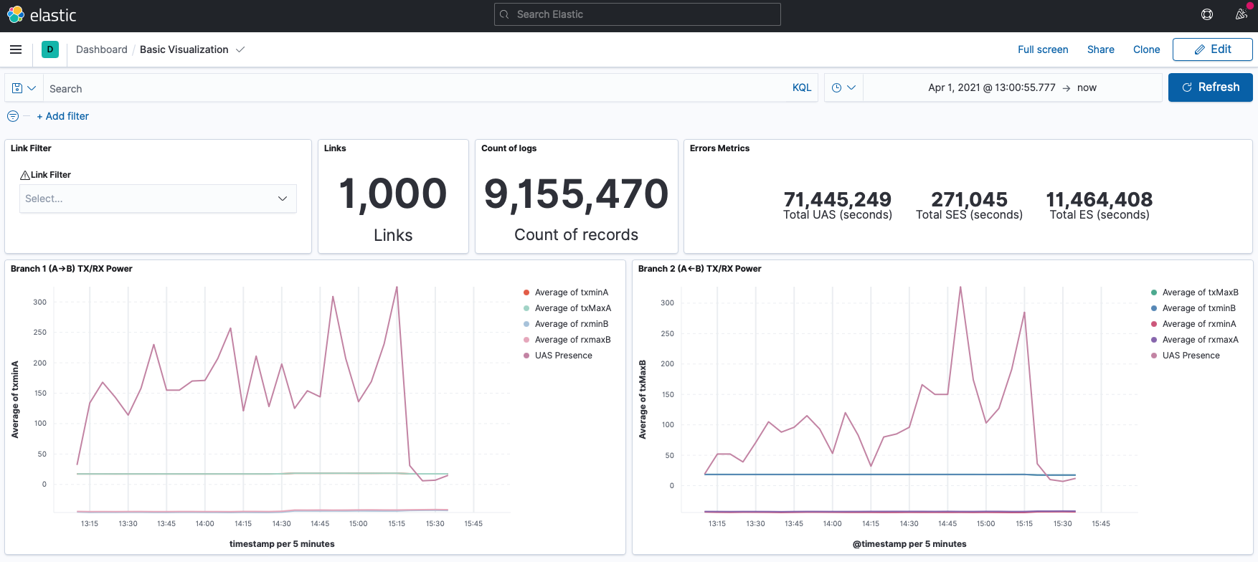
How A Kibana Dashboard Look Likes

Slide 13

Distributed computing engine
Each cluster is composed by a master and many workers
The master handles everything that concerns data distribution and job scheduling on the cluster
Workers receive tasks, execute them and send results back to master
The user provides a script written in python or java spark bindings
It includes a distributed machine learning library built with parallel execution as goal (scikit learn for spark is available as third party library)

Slide 14
Spark Role In The Pipeline
Spark will run machine learning model on the data saved on Eleasticsearch
Results will be saved on the database and visualised on a Kibana dashboard

Slide 15
Managing And Deploying The Pipeline
The most challenging part in distributed architectures is managing the underlying hardware and operating systems
The first evolution came with virtualisation, but still VMs needs operating system and software installs, security patches applications and in case another instance is needed everything should be redone from scratch
Containers solve this problem by also abstracting the operating system

Slide 16
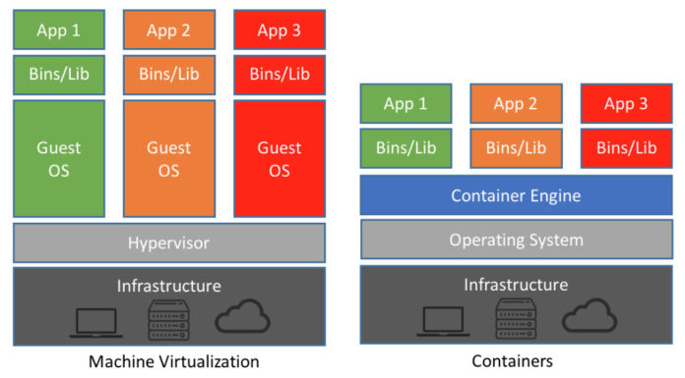
Container vs VM
Containers are lightweight VMs that run only the application and the required dependencies
Call to the OS are forwarded to the Host (OS Virtualisation)

Slide 17

Docker is a the engine that run the containers
Container are created as instances of images
Pre-built images are available from the Docker registry
Application configuration is provided on start by mounting the configuration files inside the container
A container is stateless: once deleted the data inside are also deleted. However, persistences mechanism are provided
Compose: one file cluster specification

Slide 18
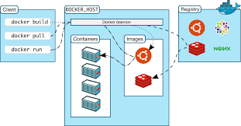
Docker Architecture

Slide 19
Docker Advantages
No VM management required: each security or software update is managed by the image creator
Hardware allocation is managed by the docker engine
Container environment is isolated from the host
Full portability: the cluster can be run on a development machine or in a data center by just moving the docker compose file
Scalable: if a new instance of a pipeline component is needed it can be spawned in few seconds

Slide 20
Cluster Monitoring
Cluster monitoring is crucial in a production environment
Metrics allow health checks and help identify when scaling is needed to avoid bottlenecks on the pipeline
The same tool in the pipeline can be reused also for the monitoring of the pipeline itself
Metricbeat collects cluster metrics and saves them to a dedicated Elasticsearch index
A Kibana dashboard is used to perform monitoring

Slide 21
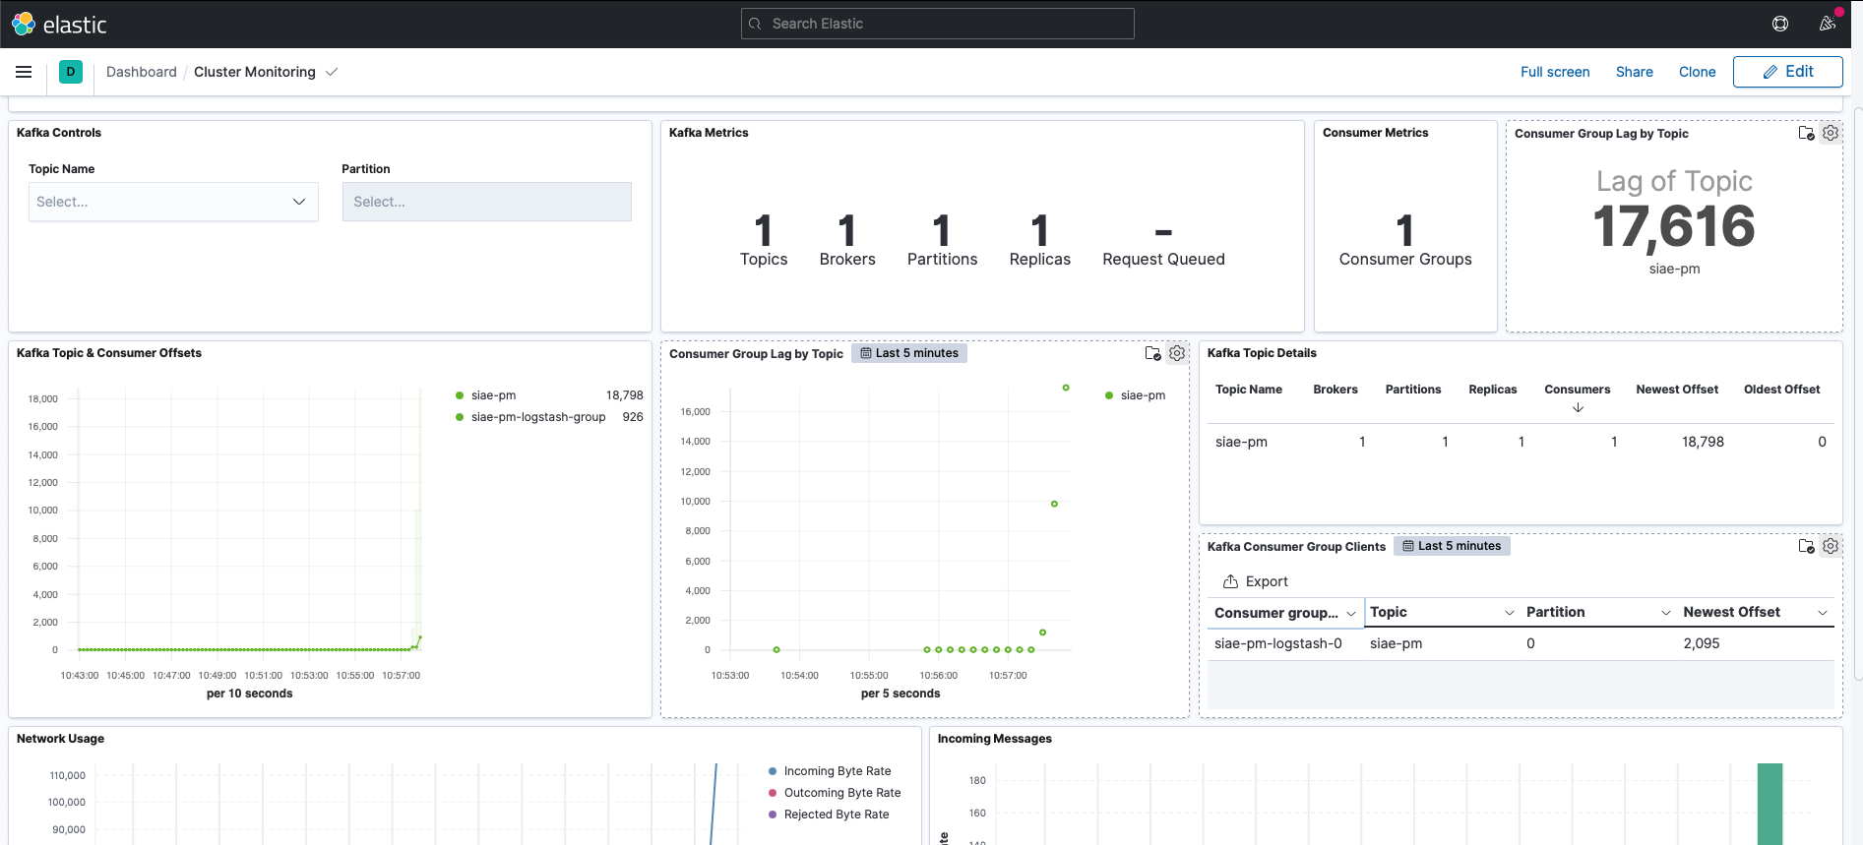
Monitoring Dashboard

